Slide 1
9 March, 2023
pghscience
Why should I choose Physics?
Question: Where do we use Physics in everyday life?

Slide 2
What is Physics?
https://www.youtube.com/watch?v=HuZZpJJF71U

Slide 3
Everyday life and Physics
Physics extends well into our everyday lives, describing the motion, forces and energy of ordinary experience. In actions such as walking, driving a car or using a phone, physics is at work. For everyday living, all the technologies you might take for granted exploit the rules of physics.
The goal of physics is to understand how things work. Physics reveals the mathematical beauty of the universe at scales ranging from subatomic particles to black holes. Studying physics strengthens quantitative reasoning and problem solving skills which are also valuable in areas beyond physics.

Slide 5
So what is the Physics course like?
We study the AQA GCSE Physics course which involves 2 1hr 45 minute papers at the end of the course. There are 8 main areas of study –
Energy
Electricity
The Particle Model of Matter
Atomic Structure
Forces
Waves
Magnetism and Electromagnetism
Space
Paper 1
Paper 2

Slide 6
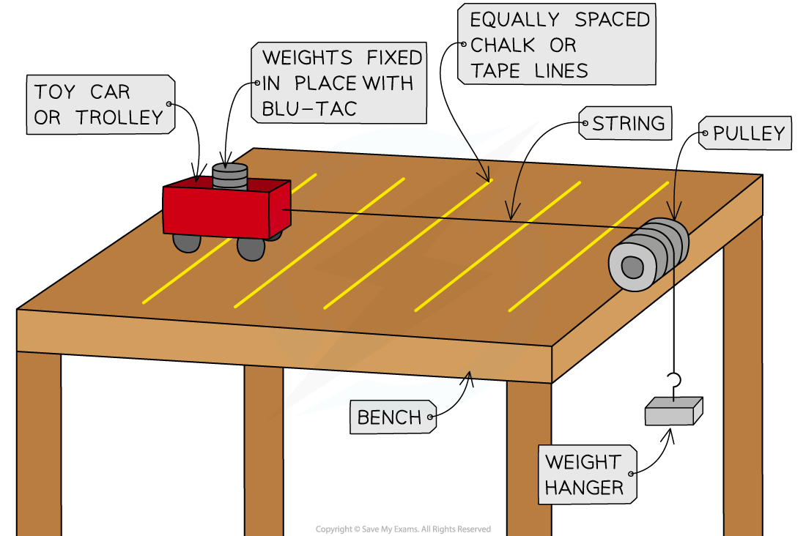
So what is the Physics course like?
There are also 10 required practical's. These are investigations that are carried out in class and you may get asked about them in the exam.
Specific heat capacity
Thermal insulation
Resistance
IV characteristics
Density
Force and extension
Acceleration
Waves
Light
Radiation and absorption

Slide 7
Unit 8 of Physics is all about space!

Slide 8
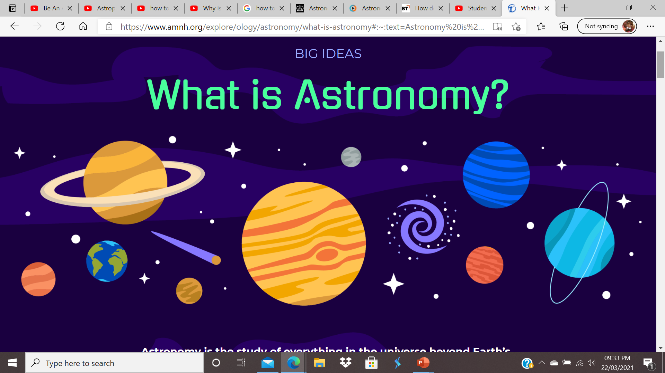
Astronomy is the study of everything in the universe beyond Earth’s atmosphere. That includes objects we can see with our naked eyes, like the Sun, the Moon, the planets, and the stars. It also includes objects we can only see with telescopes or other instruments, like faraway galaxies and tiny particles. And it even includes questions about things we can't see at all, like dark matter and dark energy .

Slide 9
It takes a team of people working together to study the universe
When you think of an astronomer, maybe you’re imagining someone using a telescope to collect data about objects in the sky. Some astronomers do that—they’re called observational astronomers. But there are lots of other kinds of astronomers too!
Do you like to build things? Make things work? Write computer programs? Solve equations? There are astronomers who do all different things like these.

Slide 10
Hear from an astrophysicist
https://www.youtube.com/watch?v=T-X4rMu6usI

Slide 11
Hear from an astronomer
https://www.youtube.com/watch?v=WYlWN_keVkY

Slide 12
What if a career in science isn’t for me? How can science help me?
https://www.youtube.com/watch?v=wstW5jy_WAU

