Slide 1
Geography as a GCSE option
Hi Year 9 (and parents)!
As Head of Geography it falls to me to sell my wonderful subject as a GCSE option.
Throughout this presentation you will find information on why you should consider Geography, what career paths it may lead to and what the course is like.
Let’s get cracking!
Mr Bowles
(Head of Department)

Slide 2
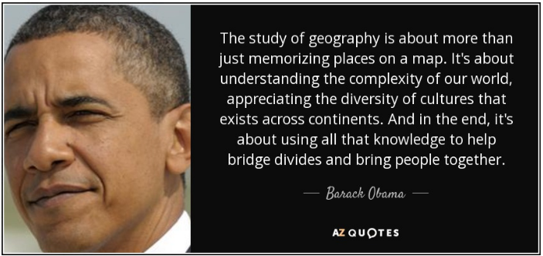
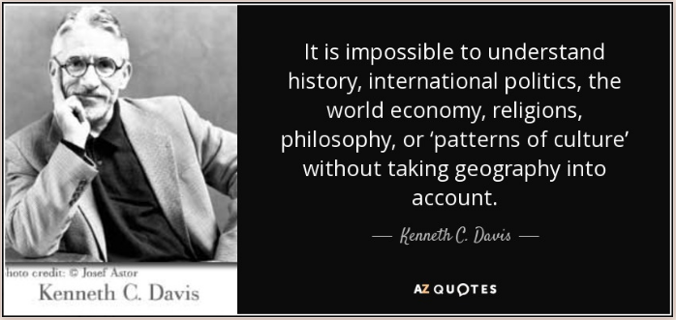
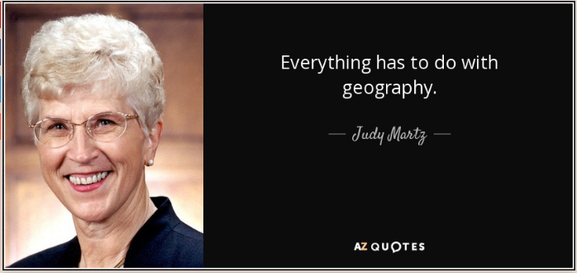
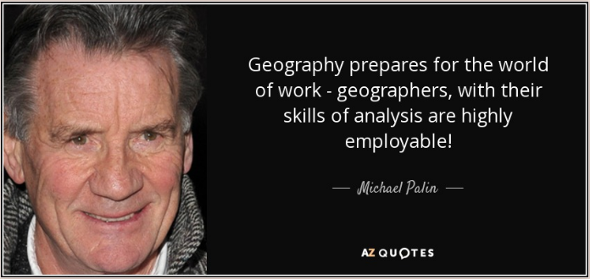
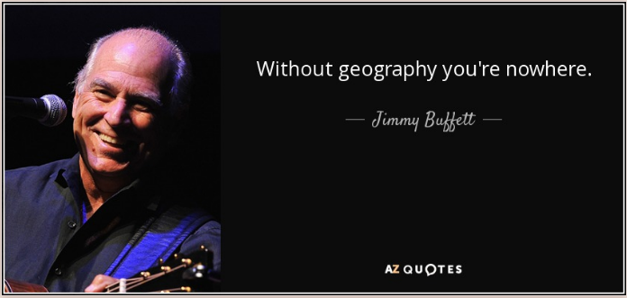
Thinking about Geography as a GCSE option?

Slide 3
Thinking about Geography as a GCSE option?
Geography is the study of our wonderful planet; isn’t that about as important as it gets?!
Geographers help us to understand the Earth, so we can use and interact with it in a more sustainable, safer and harmonious way.

Slide 4
Is Geography for me?
You will pretty much know the answer to this one already!
The GCSE Geography course combines the study of content you are familiar with already (like development, rivers landscapes and world biomes) with new and interesting topics on issues like the emergence of India and our use of resources.
g
Basically, if you have liked the subject so far, the GCSE will not disappoint!

Slide 5
I don’t want to learn countries and colour in maps…
Good, because this out-of-date view of Geography couldn't be further from what we do! (Okay, maybe we like to colour the odd map now and again…but who doesn’t love a nice map eh?!)
With the population of the world predicted to be 11 billion by 2100 (United Nations, 2018) we NEED Geographers to study the planet and how we can continue to live on the planet without damaging it beyond repair.

Slide 6
That sounds sensible enough, but what
actual jobs could a Geographer do?
There are actually two parts to this answer…
Firstly, the wide and varied nature of Geography means that there are hundreds of jobs directly linked to the KNOWLEDGE you learn as a Geographer, where you study or work in the natural environment.
Secondly, the SKILLS you develop as a Geography can be applied to a massive amount of employment sectors beyond traditional Geography-based jobs.
The next few slide will link you to websites where you can explore more…

Slide 7
Here is what Prof. Joe Smith, Director of the
Royal Geographical Society has to say…
https://www.youtube.com/watch?v=JrNd7qItKVI

Slide 8
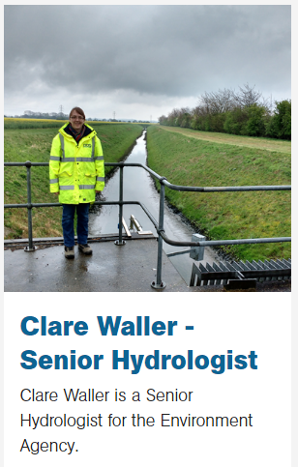
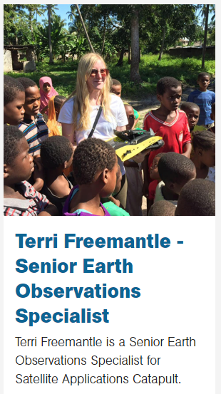
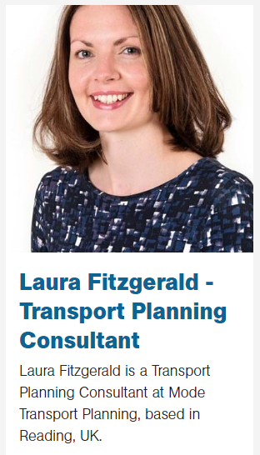
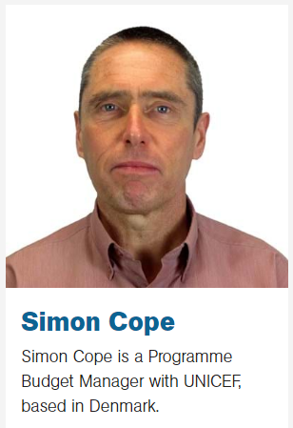
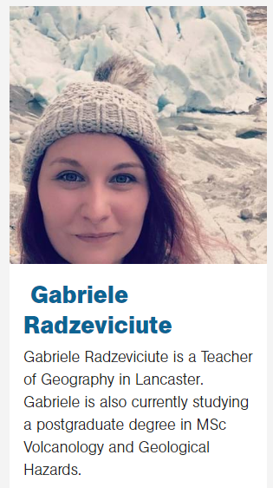
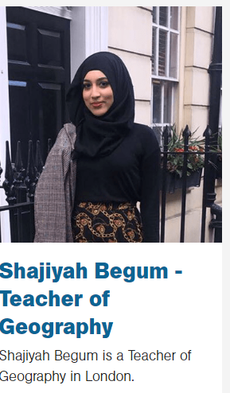
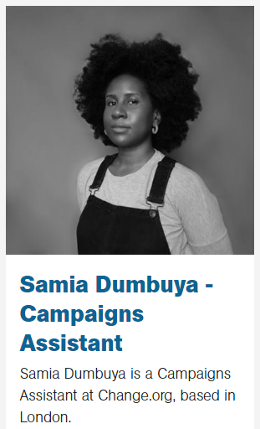
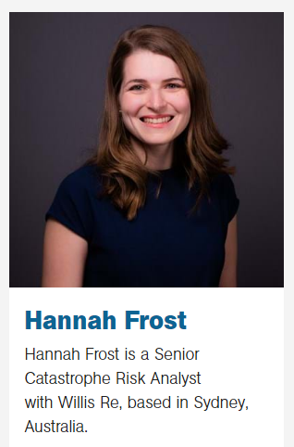
“I am a
Geographer”
Click on any of the people here to find out more about how Geography has opened up a particular career path to them. There are LOADS more “I am a Geographer” profiles here.

Slide 9
So what is the course like?
We study the GCSE written and provided by the examining board Edexcel, and we have chosen their Specification A.
There are 8 main areas of study…
UK Changing Landscapes – covers river and coastal landscapes
Resource management – a particular focus on sustainable energy resources
Ecosystems, biodiversity and management – looking after natural landscapes
Weather hazards and Climate Change – monitoring, reducing and preparing
Global Cities – near and far; we study Sao Paulo (Brazil) and Preston
Global Development – a particular focus on India
Geographical Investigations – fieldtrips to study changing urban environments and a river landscape
UK Challenges – how we will deal with a growing population,
climate change, transport provision to name just a few.

Slide 10
So what is the course like?
Here are videos from Edexcel on a few of the topics. This will give you an idea on what the level is like in terms of vocabulary, detail and understanding…
https://www.youtube.com/watch?v=7Wi8EL-kJH8
https://www.youtube.com/watch?v=lV51FEOPOB4
https://www.youtube.com/watch?v=72My4_uh8bE

Slide 11
And lessons, what are they like?
In class, lessons will seem familiar. We use a format for lessons that lower school pupils are used to. You are taught for 3 lessons a fortnight with homework each week. Lessons are a mix of group, independent and whole class work.
You can access a typical lesson on the options page of the school website or by clicking on the link below to some Stream uploads of lessons during lockdown.

Slide 12
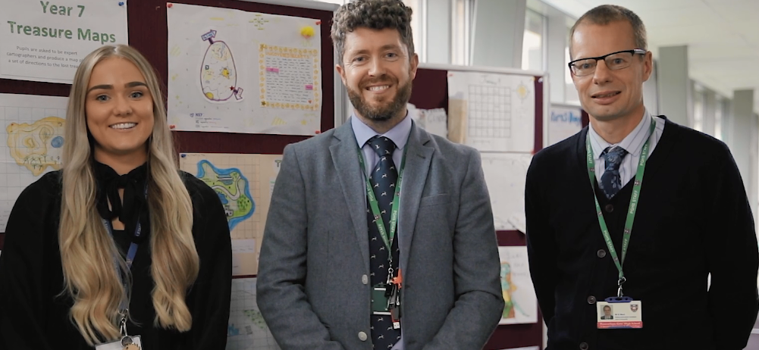
Who will teach me?
GCSE Geography at PGHS is delivered by subject specialists, myself, Mr Bowles, and my colleagues Miss Wignall and Mr Ward…the dream team!

Slide 13
How can I find out more?
Please don’t hesitate to drop me a line if there are questions I have not answered in this presentation, (g.bowles@penworthamgirls.lancs.sch.uk).
You can come to speak to me in school and look over some GCSE exercise and text books, and there will be a Futures Evening in school on 21st April.
Mr Bowles

