Slide 1
23 February, 2022
pghscience
Why should I choose Chemistry?
Question: Where do we use chemistry is everyday in everyday life?

Slide 2
Everyday life and Chemistry
The applications of chemistry directly affect our daily lives—what we eat, what we wear, our transport, the technology we use, how we treat illnesses and how we get electricity—to name just a few. Research is constantly deepening our understanding of chemistry, and leading to new discoveries
Chemistry is important because everything you do is chemistry! Even our body is made of chemicals. Chemical reactions occur when we breathe, eat, or just sit there reading. All matter is made of chemicals, so the importance of chemistry is that it's the study of everything Carl Sagan

Slide 3
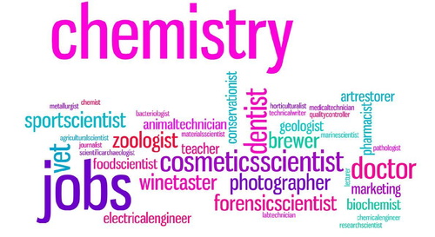
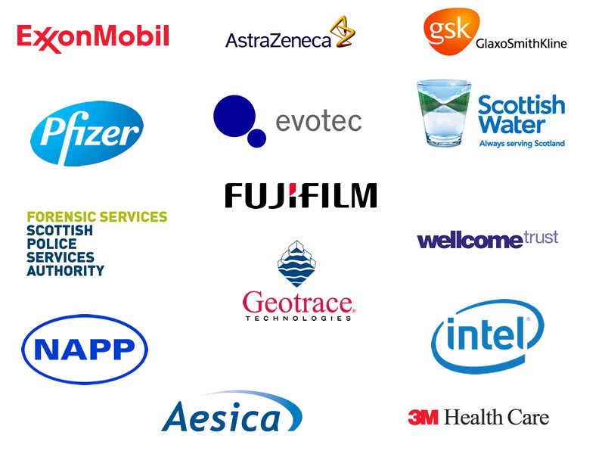
Careers in Chemistry
Analytical Chemist.
Chemical Engineer.
Chemical Development
Engineer.
Lecturer / Teacher
Environmental Chemist.
Forensic Researcher.
Forensic Scientist.
Pharmaceutical chemist
The list goes on…..

Slide 4
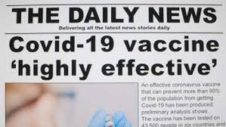
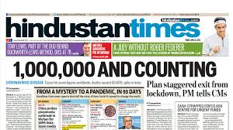
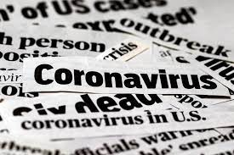
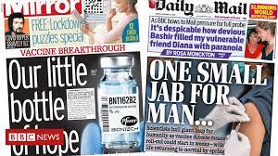
Chemistry was of vital importance in 2020!!
But things are starting to change…..

Slide 5
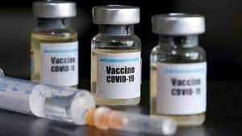
How was the coronavirus vaccine made possible?
Chemistry of course!!
disclaimer - and biology…

Slide 6
Drug development
Drug development is the process of bringing a new drug molecule into clinical practice. In its broadest definition this encompasses all steps from the basic research process of finding a suitable molecular target to supporting the commercial launch of the drug.
This relies heavily on scientists and in particular pharmaceutical chemists!!

Slide 7
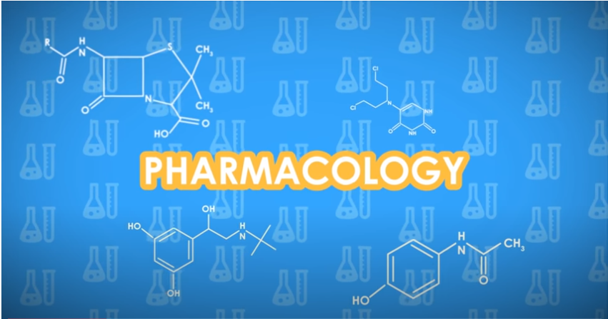
https://www.youtube.com/watch?v=PQ2m-nrf2z8
Pharmacology is the study of the action of drugs in the widest possible sense, encompassing many types of chemicals as well as a medicines that affect the functioning of the body. Pharmacologists study how drugs work in the body and use this information explore how the body itself functions

Slide 8
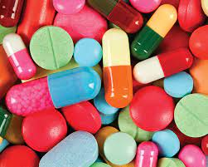
Drug development
Chemists and pharmacologists will identify different chemical compounds that can be used to treat a number of different diseases.
These chemicals can be modified
to make them more effective or
more targeted.
This is all done to ensure the safety
of the drugs and the patients.

Slide 9
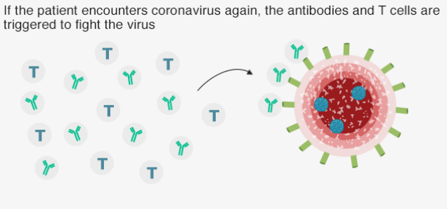
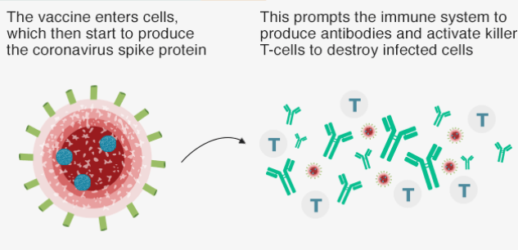
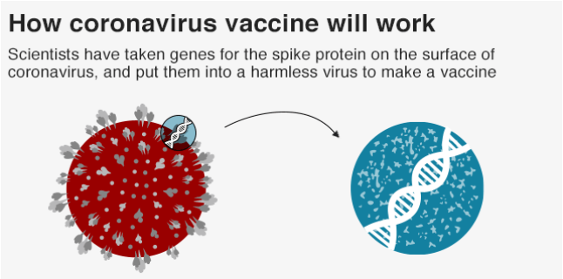
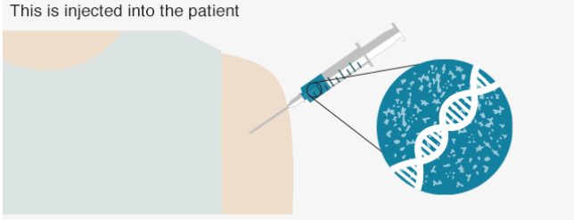
The same processes were used to create the COVID-19 vaccine.

Slide 10
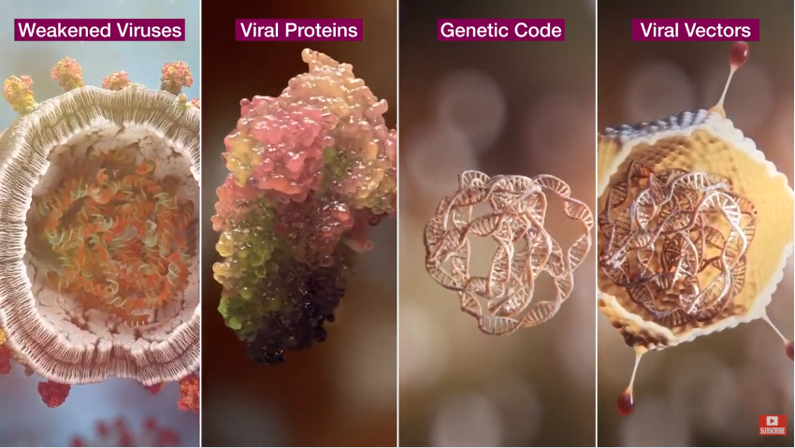
Here’s a video from AstraZeneca who make 1 of the COVID-19 vaccines being used in the UK.
https://www.youtube.com/watch?v=v3EgVVnZZPE

