Slide 1
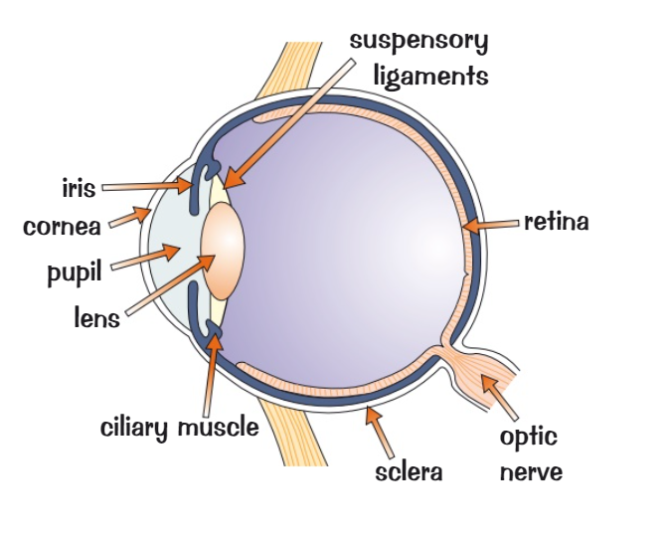
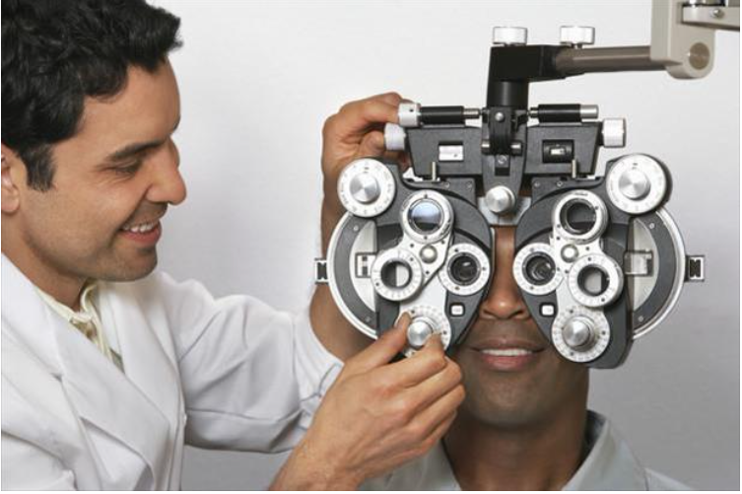
Studying Biology
Optometrists
Optometrists are primary healthcare providers who offer a range of patient care encompassing sight testing and correction as well as diagnosis, treatment, and management of changes in a person’s vision.
Salaries start at £25,000 rising to up to £65,000
A detailed knowledge of the eye is required to practice optometry. The eye and correction of eye defects are studied in Unit 5 Homeostasis and response in Separate Biology
https://youtu.be/nhdeagg1ELY

Slide 2
The structure of the Eye
The eye contains light sensitive receptor cells in the retina of the eye, these detect light and send impulses to the brain
The iris controls the size of the pupil regulating the amount of light entering the eye
The cornea, suspensory ligaments and the lens are involved in focusing light on the retina

Slide 3
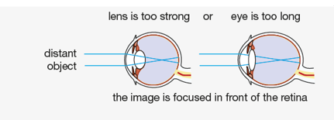
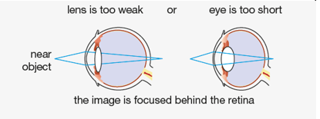
Eye Problems
Myopia – Short Sightedness
Hyperopia – Long Sightedness
People with Myopia (short-sight) can focus clearly on objects that are close to them.
People with Hyperopia (long-sight) can focus clearly on objects that are in the distance.
However, they cannot focus clearly on distant objects. The image forms in front of their retina resulting in blurred vision.
However, they cannot focus clearly on objects that are close to them. The image is focused behind their retina resulting in blurred vision.

Slide 4
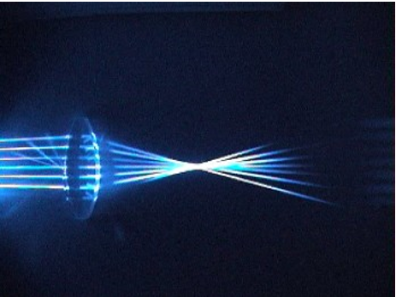
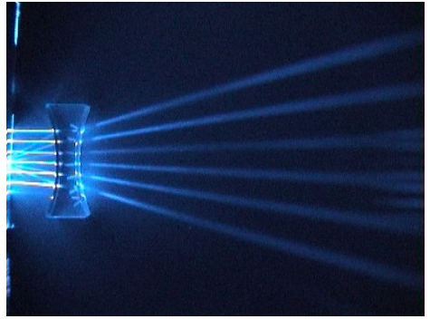
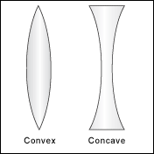
Optometrists use lenses to help correct vision.
A convex lens (converging lens) can focus the light that enters it and direct it to one point.
A concave lens (diverging lens) makes the light rays move away from each other (spread out)
Convex lenses and concave lenses refract light in different ways.

Slide 5
You are the
Optometrist
Patient 1 – Explains that they are able to see objects in the distance clearly but are struggling to focus on small text in their morning paper
Patient 2 – Explains that they are able to see objects close by but are struggling to recognise friends approaching in the distance
1. Using your knowledge of sight problems suggest what condition they may have
1. Using your knowledge of sight problems suggest what condition they may have
2. Using your knowledge of lenses suggest what type of lens could be used in their glasses to correct this problem
2. Using your knowledge of lenses suggest what type of lens could be used in their glasses to correct this problem

Slide 6
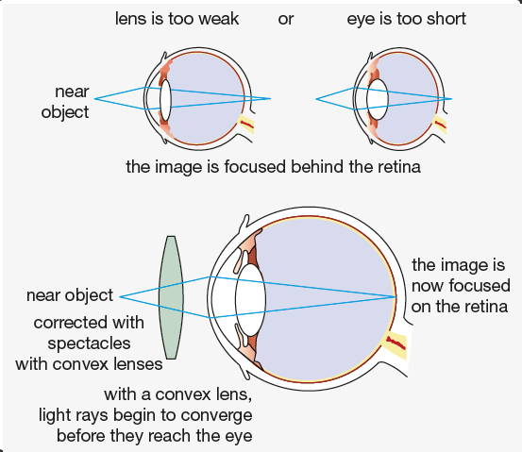
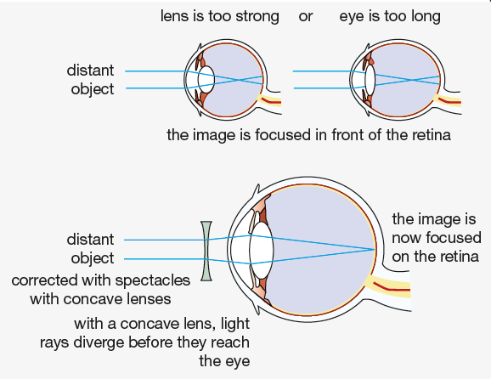
Patient 1 - Diagnosis
Patient 2 - Diagnosis
How did you do?

Slide 7
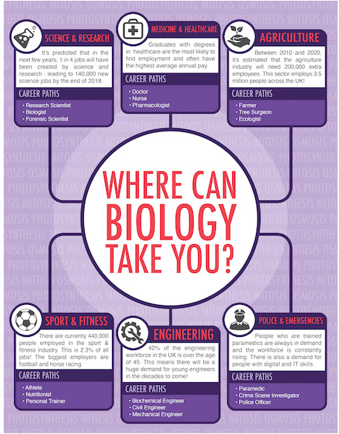
Optometry is just one of many careers linked to Biology

