Slide 1
Closing the Reading Gap
Week 4
w/c 6th December
Background information
Quick tips
Easy strategies

Slide 2
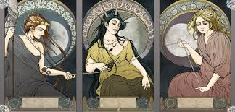
Quick wins – developing strategic reading
development of events outside a person's control, regarded as predetermined by a supernatural power.
Greek mythology
Fate
Word webs – a way to activate prior knowledge or assess understanding before and after a text.
Fatal
Death
Tragedy
A pair of star crossed lovers
O! I am fortune’s fool
My grave is like to be my wedding bed

