Slide 1













These icons are used on slides as a visual guide to tell you what to do for each slide.
Write
Read
Fill in
Match up
Draw
Investigate
Look
PA
Self-assess
Mark in
green pen
Peer-assess
Mark in
green pen
Calculate
Print
Think
Watch
Retrieval practice.

Slide 2


Silent Starter – leave some space for your objective
24 March, 2021
Formation of an insoluble compound will sometimes occur when a solution containing a particular cation (a positively charged ion) is mixed with another solution containing a particular anion (a negatively charged ion). The solid that separates is called a precipitate.
Some metal compounds, particularly transition metals, found colourful precipitates. This provides chemists with a useful way of identifying them.
Which other method have we studied to identify metals in compounds? Which metals can we already identify?
pghscience

Slide 3

24 March, 2021
pghscience
Metal Hydroxides
LO: Explore the use of precipitate tests to identify metal ions
Learning Outcomes:
Describe the method for precipitate tests
Identify metal ions based on their precipitate tests
Keystone Words:
Precipitate, hydroxide, ion
I can | Carry out precipitate tests
I can | Identify unknown metal compounds based on precipitate tests
I can | Write symbol equations for the reactions occuring

Slide 4
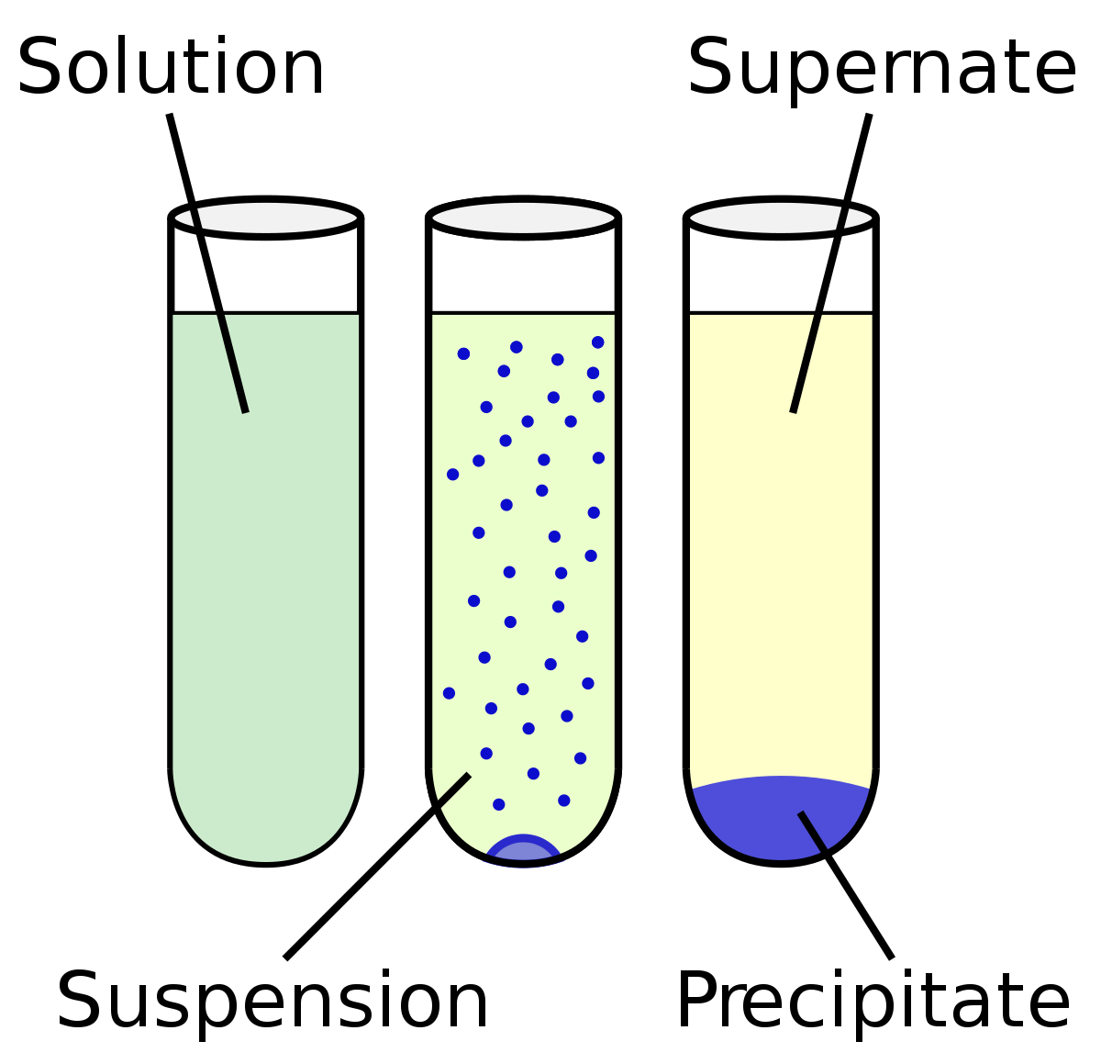
Key Word
Write
Precipitate: An insoluble solid that is produced from a solution

Slide 5
Key Knowledge
Read
What’s the difference between iron (II) sulphate and iron (III) sulphate?
The number in brackets (written in roman numerals) tells us the charge on the iron ion.
Iron (II) is Fe²⁺ , iron (III) is Fe³⁺

Slide 6
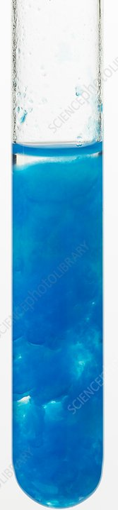
Theory
Read
When sodium hydroxide is added to some metal compound solutions, it forms an insoluble hydroxide. These are often coloured compounds, which gives chemists a way of identifying unknown compounds.
You will need to use this method, along with some others, to identify a range of unknown, colourless solutions.

Slide 7
Method
Write
1. Label six test tubes ‘1’ to’ 6’.
2. Add a 2 cm depth of copper(II) sulfate solution to test tube 1. Now add a few drops of dilute sodium hydroxide solution. Observe the products and record your results in the table below.
3. Repeat the procedure using iron(II) sulfate in test tube 2 and iron(III) chloride in test tube 3, aluminium chloride solution in test tube 4, calcium chloride solution in test tube 5 and magnesium chloride solution in test tube 6. Record the results.
4. If the precipitate formed was white, add excess sodium hydroxide and record any changes.
https://www.youtube.com/watch?v=ESQYWh02Ykg
Watch

Slide 8
Results
Draw
Tube | Reactants | Colour of precipitate | Name of precipitate
1 | copper(II) sulfate + dilute sodium hydroxide
2 | iron(II) sulfate + dilute sodium hydroxide
3 | iron(III) chloride + dilute sodium hydroxide
4 | aluminium chloride + dilute sodium hydroxide
5 | calcium chloride + dilute sodium hydroxide
6 | magnesium chloride + dilute sodium hydroxide

Slide 9
Results
Fill in
Cation being tested | Colour of precipitate
Copper (II) | Blue
Iron (II) | Green
Iron (III) | Brown
Aluminium | White
Calcium | White
Magnesium | White
How do we tell the difference between the white ones?
Add excess NaOH, precipitate re-dissolves
Flame test (orange/red)

Slide 10

How can we remember all this?
Think
Copper’s wear blue uniforms
Iron (II): Green has 2 e’s
Iron (III): Iron gets rusty, rust is brown
All three that end in “ium” produce a white precipitate
Aluminium re-dissolves
Al just re-dissolve then
NOTE: In another lesson, you will learn how to use flame tests to identify some metals. This will allow you to differentiate between calcium and magnesium.

Slide 11
What is actually being formed?
Write
In each reaction, the coloured precipitate is a metal hydroxide.
Eg.
Calcium chloride + sodium hydroxide → calcium hydroxide + sodium chloride
Fill in the names of the precipitates on your table
Fill in
White precipitate

Slide 12
Results
Draw
Tube | Reactants | Colour of precipitate | Name of precipitate
1 | copper(II) sulfate + dilute sodium hydroxide | Blue | Copper hydroxide
2 | iron(II) sulfate + dilute sodium hydroxide | Green | Iron (II) hydroxide
3 | iron(III) chloride + dilute sodium hydroxide | Brown | Iron (III) hydroxide
4 | aluminium chloride + dilute sodium hydroxide | White (dissolves in excess) | Aluminium hydroxide
5 | calcium chloride + dilute sodium hydroxide | White | Calcium hydroxide
6 | magnesium chloride + dilute sodium hydroxide | White | Magnesium hydroxide

Slide 13
Independent Work
Write
a) A student has an iron (III) sulphate solution. What is the charge on the iron ion?
b) When sodium hydroxide is added to solution, an insoluble precipitate is formed. What is an insoluble precipitate?
c)What colour precipitate is formed.
2. a) When testing another metal compound solution, the precipitate formed was white. The student then added excess sodium hydroxide. The precipitate did not dissolve. Which metals could be present?
b) Which method could be used to work out which metal is present?

Slide 14
Self-Assess
a) Fe³⁺
b) A precipitate is a solid formed from the reaction of two solutions. Insoluble means is does not dissolve
c) Brown
2. a) Calcium or magnesium
b) Flame test

