Slide 1
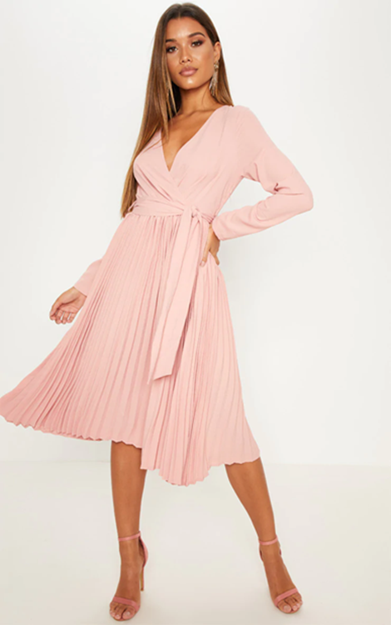
SILENT STARTER
Look at the image of the garment, Stick it in your book and label the different constructions methods used.
Sleeves
Pleats
Seams
Belt
Hem

Slide 2
Construction Techniques
This lesson you will learn to …
To develop understand of different fabric construction in order to inform design ideas
By the end of the lesson you will be able to:
a) To be able to name different fabric constructions
b) To work as a team to create a product based on a particular image, using a range of construction
c) To generate a range of ideas based on the context and client.
Objective
Outcomes
Key Vocabulary (prefix/suffix/etymology) –
three key terms used in this lesson will be:
Pleats, Gathers, darts, Hem, sleeves,

Slide 3
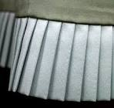
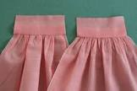
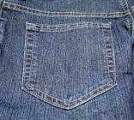
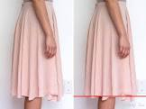
Construction techniques
Success Criteria
- To identify different construction techniques
Construction techniques are what make up a garment or Textiles product.
These include:
Pleats
Darts
Gathers
Sleeves
Pockets
Hems
Straps
Waste bands
Inserting a fastening
Learning Objective(s):
To develop understand of different fabric construction in order to inform design ideas

Slide 4
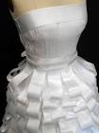
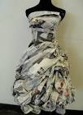
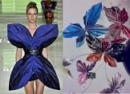
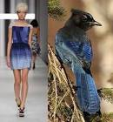
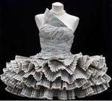
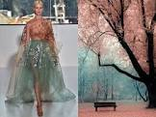
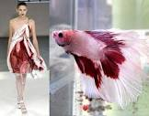
Team Task:
In groups of 3 or 4 use the images of nature and the environment
to inspire you to create a garment on the mannequins using a variety of construction techniques.
Try and get as many different techniques in as possible and be creative as possible.
Learning Objective(s):
To develop understand of different fabric construction in order to inform design ideas

Slide 5
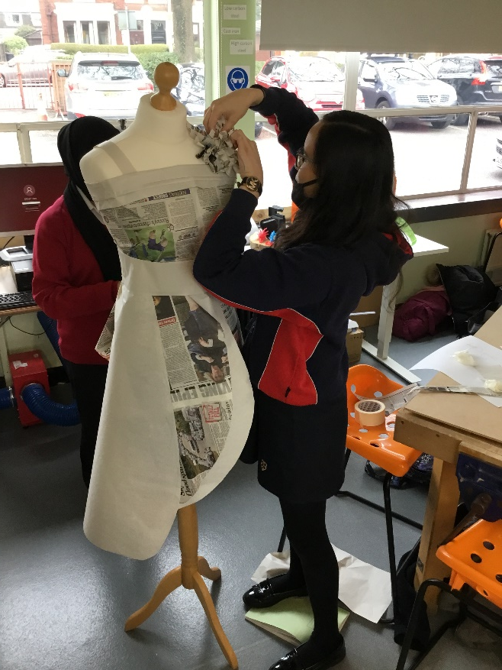
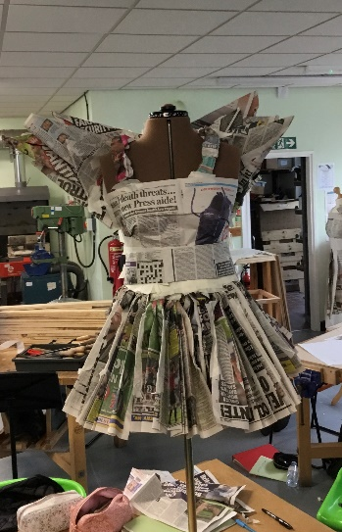
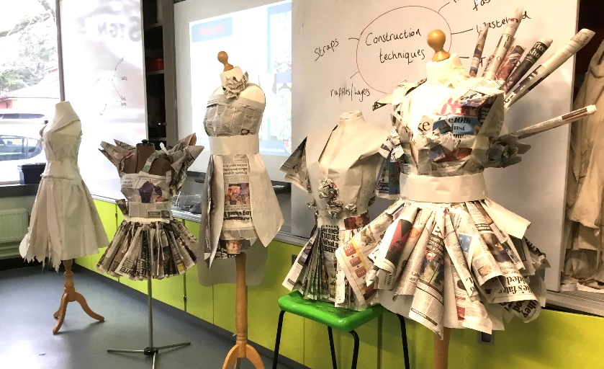
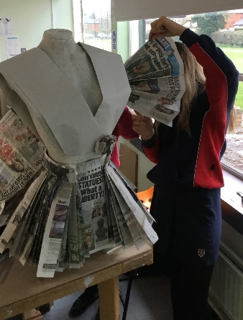
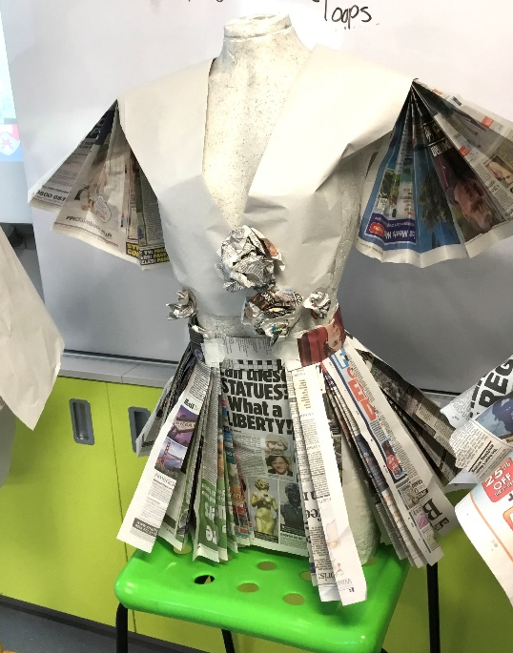
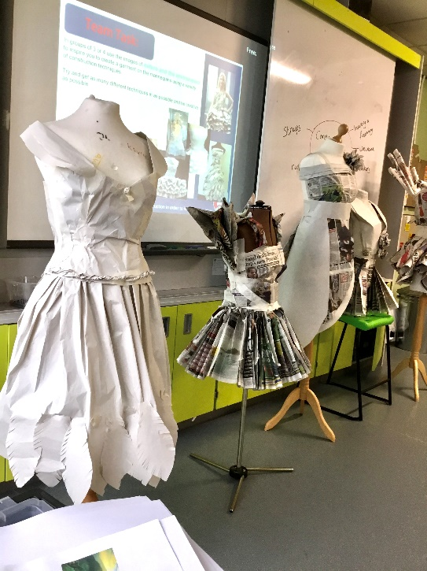
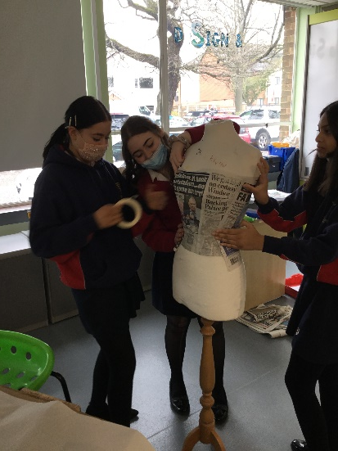
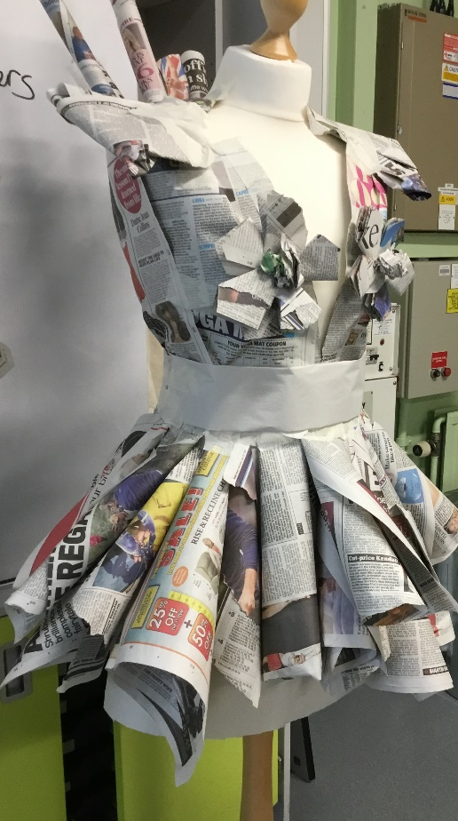
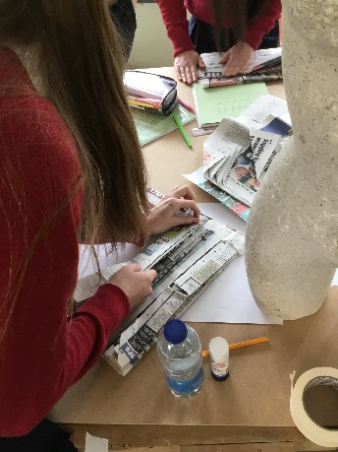
Team Task:
Past students outcomes from this task
Learning Objective(s):
To develop understand of different fabric construction in order to inform design ideas

Slide 6
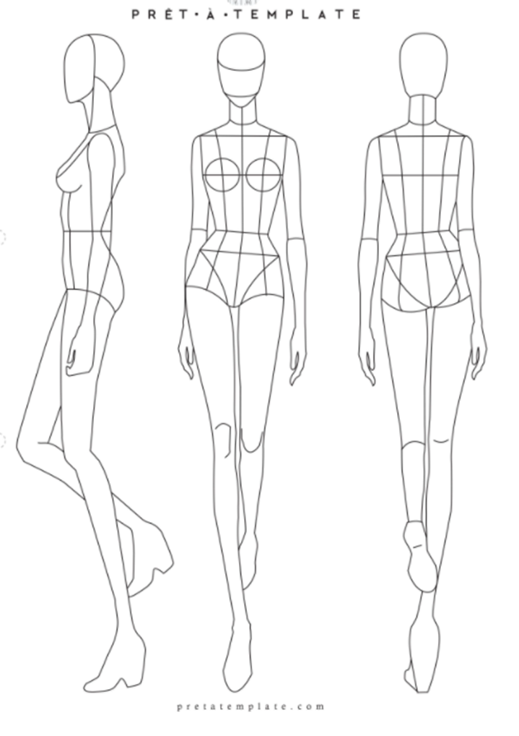
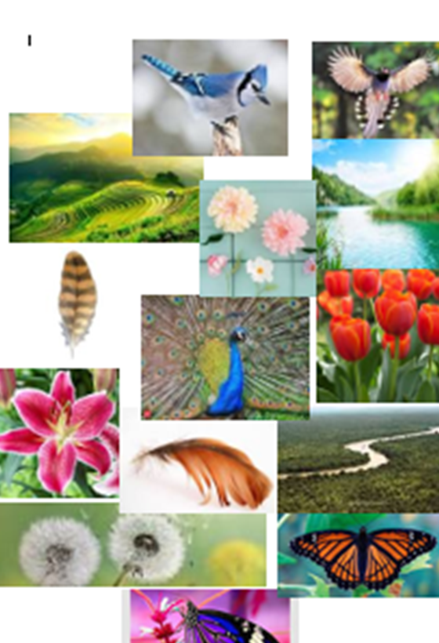
Task 2:
Keyword: Sketch
Rough, initial ideas
Generating initial ideas
Using some inspiration from the group task, Now start to sketch some ideas for a garment based on the images from the Nature and Environment inspiration board.
You may use the body templates to help you and remember to add colour and annotation, an example is shown below
Annotating ideas:
When annotating, discuss the following points:
Materials
Techniques
Fastenings
Construction ( shape; sleeves, collars, darts, pleats etc)
Components
How does it meet the needs of the brief
Environmental effects
Learning Objective(s):
To develop understand of different fabric construction in order to inform design ideas

