Slide 1


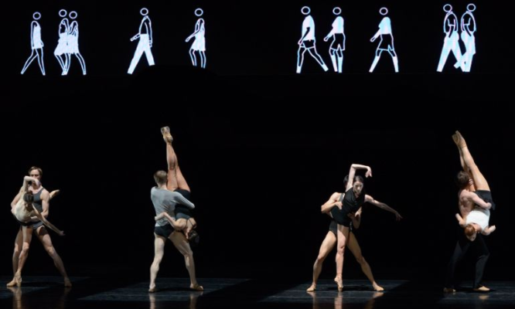
GCSE Dance - Infra
Learning Objective:
To understand the costume used for the Professional work, Infra.
Learning Outcome:
To demonstrate your knowledge of the costume for the Professional work, Infra.

Slide 2
Silent Starter:
Answer the following questions:
What are the two choreographic intentions for Infra?
Who choreographed Infra?
When was Infra first performed?
What dance company performs Infra?
Who designed the costumes for the dancers in Infra?

Slide 3
Silent Starter:
Answer the following questions:
What are the two choreographic intentions for Infra? Seeing below the surface and human interactions.
Who choreographed Infra? Wayne McGregor.
When was Infra first performed? 13th November 2008.
What dance company performs Infra? The Royal Ballet.
Who designed the costumes for the dancers in Infra? Moritz Junge.

Slide 4
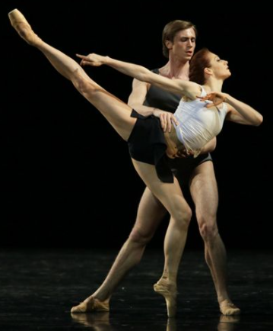
Task 1 – Infra:
https://www.youtube.com/watch?v=QUspTHgCtG0
Choose a male and a female dancer and draw the costume they are wearing.
Ensure you annotate the colour, type of clothing and maybe the fabrics if you can identify them from the video.

Slide 5
Task 2 – Infra:
https://www.youtube.com/watch?v=QUspTHgCtG0
How does the costume communicate the Choreographic intentions?
Remember the choreographic intentions are ‘seeing below’ and ‘human interactions’.

Slide 6
Task 2 – Infra:
https://www.youtube.com/watch?v=QUspTHgCtG0
How does the costume support the movement of Infra?
Easy to move in.
Tight fitting so can see the lines of the body.
Pointe shoes lengthen the lines of the legs.

Slide 7
GCSE Dance - Infra
Learning Objective:
To understand the costume used for the Professional work, Infra.
Learning Outcome:
To demonstrate your knowledge of the costume for the Professional work, Infra.

