Slide 1
GCSE Computer Science
Edexcel 1CP2 – New Specification 2020
SLR 6 – Environmental, Ethical and Legal

Slide 2
SLR 6 – Ethical and legal issues
Lesson Objective
Understand what the ethical and legal issues with personal data are.

Slide 3
Needed for the exam!

Slide 4
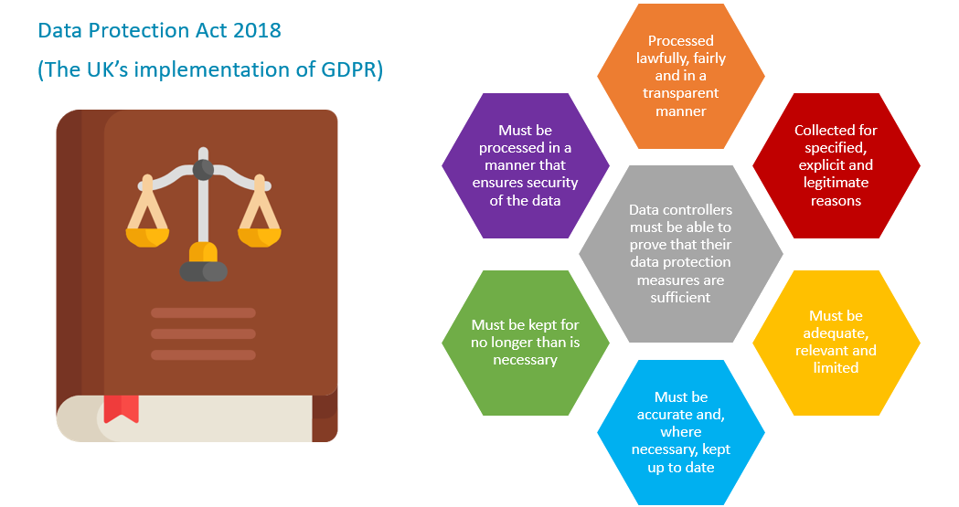
Needed for the exam!

Slide 5
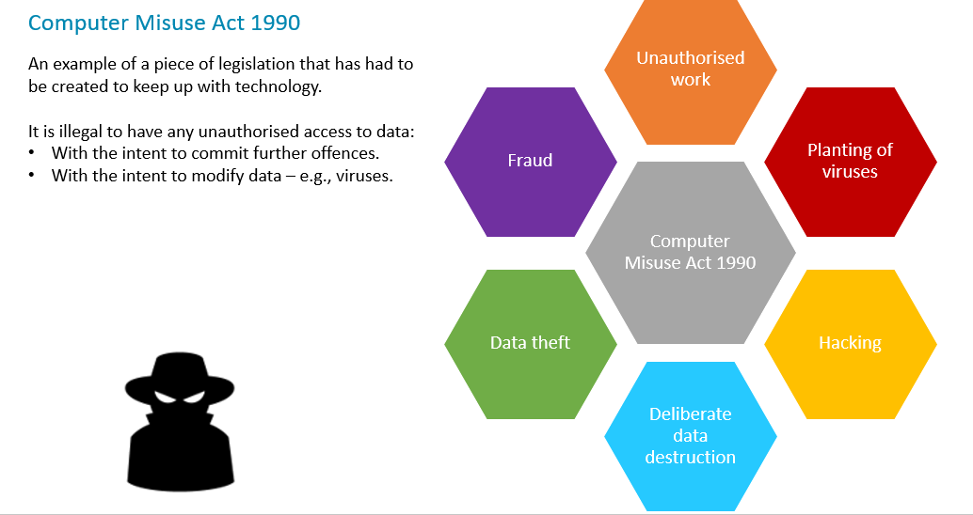
Needed for the exam!

Slide 6
Needed for the exam!

Slide 7
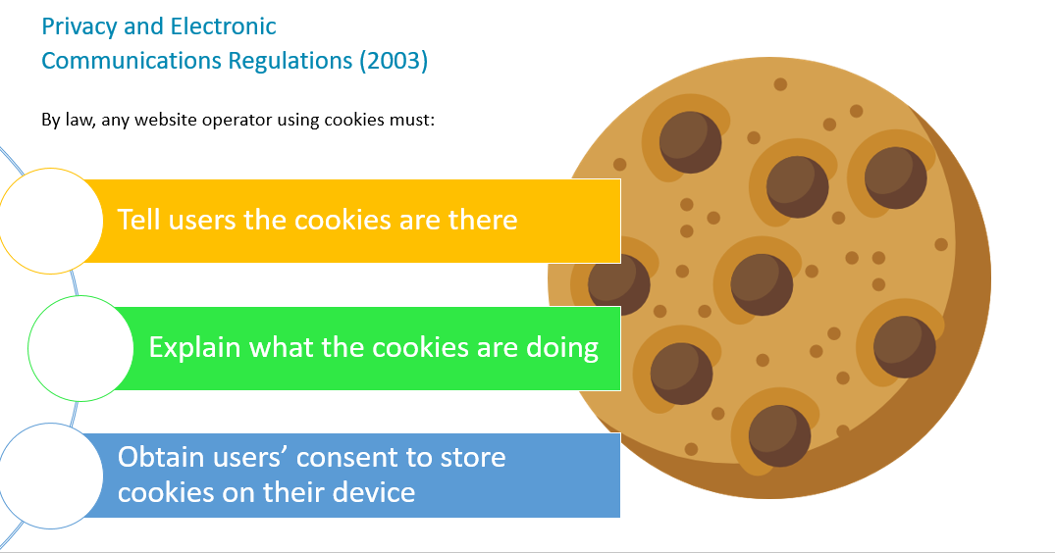
Needed for the exam!

Slide 8
Key Questions
What are the ethical issues of computing?
Write your answers down

Slide 9
Question 1
The internet has given rise to an increase in piracy, distribution of illegal images, offensive content, fraud, trolling and other inappropriate actions. Should the internet be regulated? Should internet service providers be responsible for the content delivered to their customers? Should social networks be responsible for the content posted to their sites?
Guidance
Step 1
State the arguments for.
Step 2
State the arguments against.
Step 3
Conclusion – what are the key arguments and justify your opinion
8 marks

Slide 10
Question 2
An increasing range of smart devices in our homes are voice-activated and capable of listening in to our daily activities. Some people argue that the government is collecting valuable information for counter-terrorism operations using this technology. Should smart devices be allowed to record us continually?
Guidance
Step 1
State the arguments for.
Step 2
State the arguments against.
Step 3
Conclusion – what are the key arguments and justify your opinion
8 marks

Slide 11
Further Ethical Issues
Research one of these ethical issues of computer science:
This house believes the impact of social media on teenage mental health is damaging.
This house believes that data privacy is an absolute and essential right, and the government should never be able to obtain your personal data.
This house believes that tracking software on mobile devices is an invasion of privacy.
This house believes law enforcement should not have to get your consent before gaining access to your personal data.
This house believes that computer games have a negative impact on the social behaviour of children.
This house believes that the advancement of computer technology is creating a “digital divide.”
8 marks

Slide 12
Task 1 Guidance
Outline the key findings to your research
Step 1
State the arguments for.
Step 2
State the arguments against.
Step 3
Conclusion – what are the key arguments and justify your opinion
8 marks

Slide 13
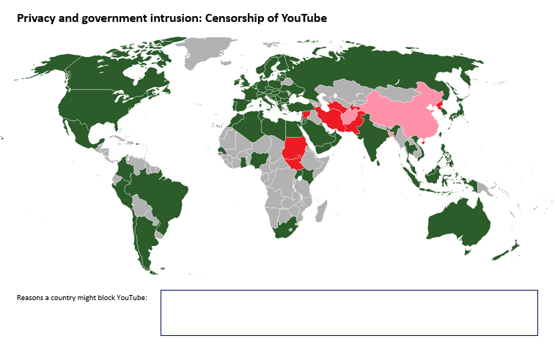
Map – Censorship of You Tube
Complete the Ethical and Legal issues worksheet (on the next slide)
Tasks
1. The countries highlighted in red block access to YouTube. Using a map of the world, label the red and pink countries highlighted. (Grey indicates a country has their own version of YouTube. Green indicates free access. Pink means “previously censored.” Source: www.en.wikipedia.org/wiki/Global_Internet_usage)
2. State the reasons why a country may choose to block access to YouTube.
3. On the map, annotate some of the additional issues surrounding data protection and privacy in Asia, Africa, America and Europe.

Slide 14
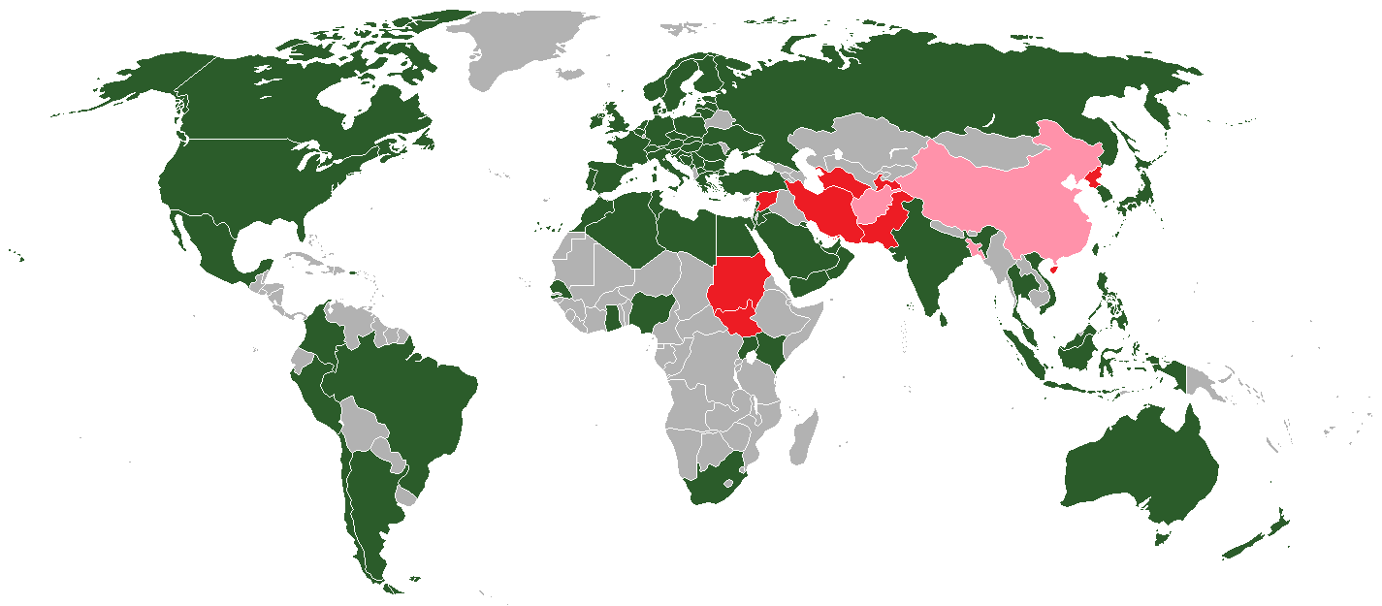
Privacy and government intrusion: Censorship of YouTube
Reasons a country might block YouTube:
Notes:
The countries highlighted in red block access to YouTube. Using a map of the world, label the red and pink countries highlighted. (Grey indicates a country has their own version of YouTube. Green indicates free access. Pink means “previously censored.” Source: www.en.wikipedia.org/wiki/Global_Internet_usage)
State the reasons why a country may choose to block access to YouTube.
On the map, annotate some of the additional issues surrounding data protection and privacy in Asia, Africa, America and Europe.

